Slide 1
WELCOME TO THE PRESENTATION
CSE103

Slide 2
COURSE CO-ORDINATOR:
ASIF HOSSAIN
GROUP MEMBERS:
IMTIAZ MISHA -13101063
NOBODIP SHARMA -13101064
PROKASH KARMOKAR -13101052

Slide 3


THEME:
HOSPITAL -
MANAGEMENT

Slide 4
TOPICS:
INTODUCTION
SLIDE CONTENT
FEATURES
APPLICATION OF OUR PROJECT
EQUIPMENTS
FLOW CHART & DIAGRAM
INFORMATION
FUTURE WORK
CONCLUSION

Slide 5
BASIC:
DOCTOR
NURSE
PATIENTS

Slide 6
WHAT IS HOSPITAL MANAGEMENT?
Hospital Management System provides the benefits of streamlined operations, enhanced administration & control, superior patient care, strict cost control and improved profitability. HMS is powerful, flexible, and easy to use and is designed and developed to deliver real conceivable benefits to hospitals. More importantly it is backed by reliable and dependable support.

Slide 7
FLOW CHART:
1ST
DOCTORS NAME WILL APPEARED
2ND
WE’LL GET THE DETAILS
3RD
NUMBER OF PATIENTS
NAME & THEIR PROBLEMS
IN-CHARGE NURSE NAME
SELECTING ANY DOCTOR
DOCTOR NAME
PATIENTS NAME
NURSE NAME
1ST
SEARCHING BY THE PATIENT NAME
2ND
PATIENT ID
WILL APEAR DOCTOR IN- CHARGE NAME
3RD
PROBLEM
NURSE NAME IN- CHARGE
1ST
SEARCHING BY THE NURSE NAME
2ND
PATIENT ID & NAME
PROBLEM
3RD
DOCTOR IN- CHARGE NAME

Slide 8
INFORMATION:
The project ‘Hospital Management System’ is based on the database, object oriented and networking techniques
Hospital Management System is custom built to meet the specific requirement of the mid and large size hospitals across the globe. All the required modules and features have been particularly built to just fit in to our requirement.

Slide 9
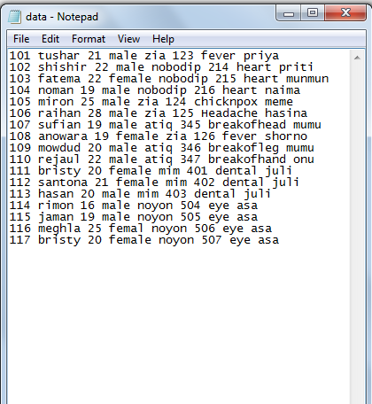
PROJECT DATA SCREANSHOT :

Slide 10
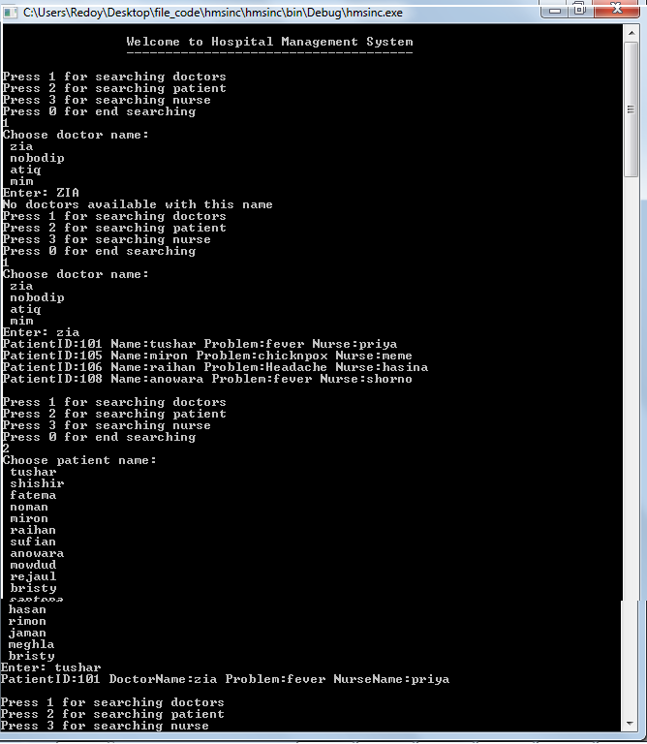
PROJECT CONSOLE LAYOUT :

Slide 11
FUTURE
PLAN:
1ST
DOCTORS NAME WILL APPEARED
2ND
WE’LL GET THE DETAILS
3RD
NUMBER OF PATIENTS
NAME & THEIR PROBLEMS
IN-CHARGE NURSE NAME
SELECTING ANY DOCTOR
SEPARATE THE DOCTORS BY THEIR SPECIALITY
THEN WE’LL GET ALL OF THESE FROM THE “SPEECIALIST BRANCE”
DOCTOR NAME
PATIENTS NAME
NURSE NAME
1ST
SEARCHING BY THE PATIENT NAME
2ND
PATIENT ID
WILL APEAR DOCTOR IN- CHARGE NAME
3RD
PROBLEM
NURSE NAME IN- CHARGE
1ST
SEARCHING BY THE NURSE NAME
2ND
PATIENT ID & NAME
PROBLEM
3RD
DOCTOR IN- CHARGE NAME

Slide 12
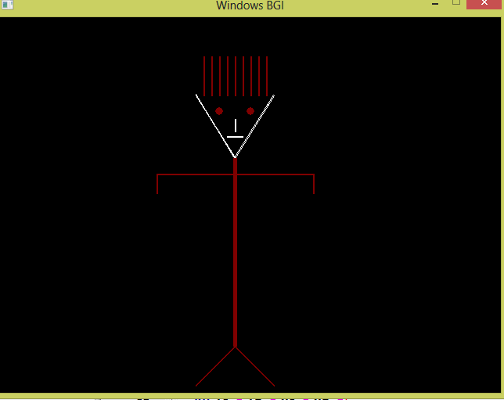
GRAPHICS PROJECT:
CARTOON DANCE WILL BE SEEN….
LIKE THIS ….

Slide 13
THIS IS THE END OF OUR PRESENTATION
THANKS TO ALL

